Slide 1

ESL and e-learning in Rural Alberta
Webinar #2
An orientation to the Guiding Principles for using e-learning with rural ESL learners
Jennifer Foote & Justine Light
ATESL Database

Slide 2

ESL/e-learning in rural Alberta
Welcome to our online presentation on meeting the e-learning needs of ESL learners in rural Alberta.
Each slide of this Powerpoint contains an audio file. To access the audio file click the icon.
The transcript of the audio file can be found in the notes section of each slide.
Notes:
Slide 2- Welcome to our online presentation on meeting the e-learning needs of ESL learners in rural Alberta. This series of webinars was created by Justine Light and Jennifer Foote with support from Alberta Human Services, Immigration Division, as part of the Innovative Project: Building skills and expertise for using e-learning with adult ESL learners.
Each slide of this PowerPoint contains an audio file. To access the audio file click the icon.
The transcript of the audio file can be found in the notes section of each slide.

Slide 3
Contents of the webinar series
Webinar #1 - An introduction to the Rural ESL context in Alberta and the potential for e-learning
Webinar #2 - An orientation to the Guiding Principles for using e-learning with rural ESL learners
Webinar #3 - An orientation to the remaining sections of the ESL/e-learning Guide for rural Alberta and the broader project, Building skills and expertise for using e-learning with adult ESL learners
Notes:
Slide 3-This webinar series contains three webinars as follows:
Webinar #1 - An introduction to the Rural ESL context in Alberta and the potential for e-learning
Webinar #2 - An orientation to the Guiding Principles for using e-learning with rural ESL learners
Webinar #3 - An orientation to the remaining sections of the ESL/e-learning Guide for rural Alberta as well as, the broader project, Building skills and expertise for using e-learning with adult ESL learners.

Slide 4
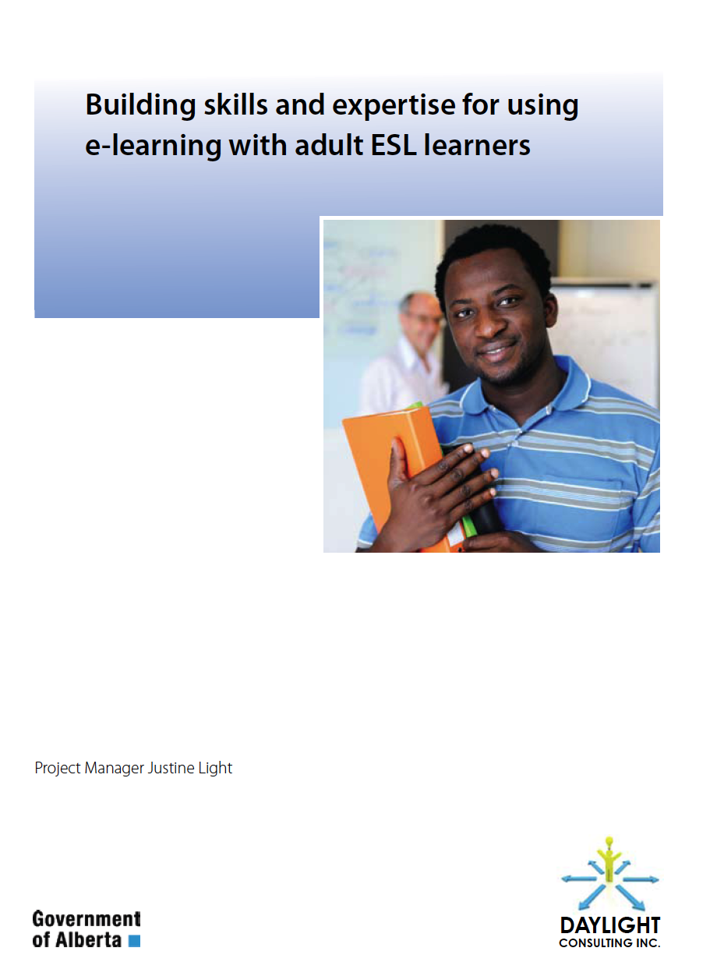


Building skills and expertise for using e-learning with adult ESL learners
Daylight
Consulting
Notes:
Slide 4- The information in this webinar on meeting the e-learning needs of ESL learners in rural Alberta is part of a larger project supporting the development of ESL/e-learning in the province. This larger project includes a manual titled Building skills and expertise for using e-learning with adult ESL learners. More detailed information about this manual is contained in Webinar #3 in this series. The manual can also be downloaded freely from the ATESL Resource database, www.atesl.ca and a limited number of hard copies are available. Information on how to access the document can be found at the end of this presentation.

Slide 5
A guide to using technology with ESL literacy learners
A large number of ESL literacy learners that are currently seeking language and literacy instruction in smaller communities.
Guiding Principles for using e-learning with rural ESL learners was designed to support ESL literacy instructors, volunteers, and programs coordinators who are endeavouring to use technology with ESL literacy learners.
Notes:
Slide 5- As was discussed in webinar 1 One of the key findings from our consultations with rural communities was the large number of ESL literacy learners that are currently seeking language and literacy instruction in smaller communities. The Canadian Language Benchmarks 2000: ESL for Literacy Learners publication defines ESL literacy learners as “individuals who are learning English as a Second Language and who are not functionally literate in their own language for a variety of reasons” (p. II). Using e-learning to facilitate ESL literacy learning presents unique opportunities and challenges. An orientation to the Guiding Principles for using e-learning with rural ESL learners was designed to support ESL literacy instructors, volunteers, and programs coordinators who are endeavouring to use technology with ESL literacy learners.
These guiding principles were informed by an extensive review of the literature in ESL literacy instruction and e-learning. In particular, the Learning for LIFE: An ESL Literacy Handbook produced by Bow Valley College, was used to inform these principles.

Slide 6
Who are ESL Literacy Learners?
ESL literacy learners bring a wide range of abilities, skills, and cultural backgrounds to the classroom.
The Canadian Language Benchmarks 2000: ESL for Literacy Learners defines ESL literacy learners as “individuals who are learning English as a Second Language and who are not functionally literate in their own language for a variety of reasons” (p. II).
Notes:
Slide 6- Who are ESL Literacy Learners? One of the greatest challenges in creating a set of guiding principles for using technology with ESL literacy learners is the wide range of abilities, skills, and cultural backgrounds that ESL literacy learners bring to the classroom. The Canadian Language Benchmarks 2000: ESL for Literacy Learners publication divides ESL literacy learners into three broad categories: learners who come from a language and cultural background that does not have a written form (referred to as preliterate learners), learners who are not literate but who come from a literate society (referred to as non-literate), and finally, learners who have some literacy skills in their first language but whose ability to read and write is limited (referred to as semi-literate).
Research has demonstrated that the amount of time it will take learners to reach a certain level of English is strongly tied to the amount education that they have had in their first language (Gardner, Polyzoi & Rampaul, 1996). Furthermore, ESL literacy learners learn differently than ESL learners who are fully literate in their first language. For these reasons, The Centre for the Canadian Language Benchmarks developed a separate set of benchmarks related to, but distinct from, The CLBs for ESL learners. The ESL literacy benchmarks begin with the Foundation Phase, which is at a pre-benchmark level and then go on to phase I, II, and III, with learners who finish phase three being at the start of CLB level 6.

Slide 7
Why use technology with ESL literacy learners?
In Canada, there are now very few jobs that require no computer use at all. Without training at school, it may be very difficult for ESL literacy learners to pick up these technological skills on their own.
Technology can also be an excellent support to learning language and literacy skills (UNESCO, 2006).
Notes:
Slide 7- Using technology with ESL literacy learners, particularly computer classes, can be difficult and frustrating. Anyone who has taken a class of low-level literacy learners to a computer lab for the first time knows the challenges! However, “literacy, language and numeracy skills in the 21st century include proficiency with digital technologies and practices, including e-learning.” (Davis & Fletcher, 2010). Technology is not simply important; it inextricably linked with literacy. Words on paper are now just one type of literate practice in a world of multimedia communication (Snyder, Jones, & Bianco, 2005).
In Canada, there are now very few jobs that require no computer use at all. Without training at school, it may be very difficult for ESL literacy learners to pick up these technological skills on their own. It is common for ESL literacy learners to feel very nervous about using technology for the first time, and to be unsure of what to do when technological problems occur. Furthermore, ESL literacy learners are less likely to have access to computers and the Internet at home when compared to the general population (Warschauer & Liaw, 2010). It is not unreasonable to say that in order to fully participate in Canadian society, most ESL literacy learners will need some technological skills and that the easiest way for them to get those skills is in their literacy classes.
Furthermore, technology has the ability to create social and informational links that would otherwise be closed off to learners. With access to the Internet, it is possible for learners to see the street where they used to live before they came to Canada using Google Earth. They can have a telephone conversation for free with anyone else who has an internet connection. They can find news from home and communicate with other people who came from their country and are having similar experiences. A small amount technological know-how can make the planet a lot smaller and friendlier.
As well as having worth in and of itself, technology can also be an excellent support to learning language and literacy skills (UNESCO, 2006). There are many good technological resources available to ESL literacy programs. Learners can listen to a short story while reading along and repeat the story as often as they like. With technology available to instructors, it is easy for classes to have audio and print versions of their own stories. Literacy and numeracy activities and games on the Internet can be fun for learners, while providing them with immediate feedback on their progress. Learners can work together to make collaborative projects using video cameras, PowerPoints, blogs, or photo programs.

Slide 8
Orientation to the GP doc
Access and Institutional Support
Orientation to using Technology with ESL Literacy Learners
ESL Literacy Pedagogical Considerations
Learners
Instructors
Notes:
Slide 8- The Guiding Principles for using e-learning with rural ESL learners is divided into five broad categories: Access and Institutional Support, Orientation to using Technology with ESL Literacy Learners, ESL Literacy Pedagogical Considerations, Learners, and finally, Instructors. I will briefly discuss each section. If you would like to read all of the GP contained in the guide I encourage you to download the full document from the ATESL resource database.

Slide 9
Access and Institutional Support
Program providers and instructors are aware of issues related to learners’ access to tech resources outside of class.
There is access to tech/tutor support when using computer labs or open assess centres.
Access to the organization’s online services are kept simple and easy to access.
Notes:
Slide 9- There are several principles that are important to consider from the standpoint of easy access and institutional support for learners.
The first of these is that program providers and instructors are aware of issues related to learners’ access to technological resources outside of class. For some learners practice outside of class time is simply not possible.
Second, there is access to technological and tutor support when using computer labs or open assess centres.
Access to the organization’s online services are kept as simple and easy to access as possible.

Slide 10
Access and Institutional Support
Icons and folders are presented to learners using consistent naming protocols.
Computer labs are designed in a way that makes it easy for instructors to move around helping learners, and for learners to help each other.
Notes:
Slide 10- Continuing with guiding principles for access and institutional support
Icons and folders are presented to learners using consistent naming protocols. For example, if a folder containing activities for learners is located in top right corner of the screen and is called ESL 1 on one computer, it will have the same name and location on all lab computers
And finally Computer labs are designed in a way that makes it easy for instructors to move around helping learners, and for learners to help each other.

Slide 11
Orientation to using Technology with ESL Literacy Learners
The e-learning environment is supportive and non-threatening.
Learners are reassured that they need not feel concerned about damaging equipment.
Notes:
Slide 11- Orientation to using Technology with ESL Literacy Learners
The e-learning environment is supportive and non-threatening. This may seem obvious but it is important to remember that some learners my feel anxious about using technology if they are not familiar with it.
One thing that can help learners relax is to ensure them that need not worry about damaging equipment.

Slide 12
Orientation to using Technology with ESL Literacy Learners
Learners are explicitly introduced to the technological skills they will need
Care is taken to ensure that the initial learning curve for learners is not too steep.
Classrooms contain different types of technology, such as computers, TVs, Mp3 players,etc.
Notes:
Slide 12- Continuing on with this section:
Learners are explicitly introduced to the technological skills they will need use both in and out of the classroom.
Furthermore is important that care is taken to ensure that the initial learning curve for learners is not too steep and that there is ample time for practice and repetition if learners require it.
Also classrooms contain different types of technology, such as computers, TVs, Mp3 players,etc. We can sometimes forget that computer are only one kind of technology that learners may not feel comfortable using.

Slide 13
ESL Literacy Pedagogical Considerations
E-learning needs for literacy learners are recognized as being distinct.
New concepts using technology are introduced slowly, incrementally, and systematically.
Collaborative learning is encouraged and learning with computers is viewed as a social activity.
Notes:
Slide 13- ESL literacy Pedagogical considerations.
E-learning needs for literacy learners are recognized as being distinct from other ESL learners and as such instructional approaches and activities used for general ESL classes may not ideal for serving learners needs.
It is also important that new concepts using technology are introduced slowly, incrementally, and systematically.
Also, Collaborative learning is encouraged and learning with computers is viewed as a social activity.

Slide 14
ESL Literacy Pedagogical Considerations
E-learning activities aim to enable learners to become autonomous technology users.
Technological skills are considered a type of literacy, not a skill separate from literacy.
Notes:
Slide 14- ESL Literacy Pedagogical Considerations continued
Another guiding priniciple is that E-learning activities aim to enable learners to become autonomous technology users. As was mentioned earlier in the webinar using technology in the classroom is not only to aid learners in learning English and literacy, but is a viewed as form of literacy in it’s own right. As technology is a type of literacy, it is important that learners become competent as using technology outside of the classroom.

Slide 15
Learners
Learners are given opportunities to develop technological skills that match their personal goals, needs, and plans.
Learners feel that their religious and/or cultural beliefs about technology are respected.
Learners are given strong instructional support when using technology to help ease frustrations with technology.
Notes:
Slide 15- Learners
There are several principles that relate specifically to learners.
First, Learners are given opportunities to develop technological skills that match their personal goals, needs, and plans.
Also, Learners feel that their religious and/or cultural beliefs about technology are respected.
It is also important that Learners are given strong institutional support when using technology to help ease frustrations with technology.

Slide 16
Learners
Learners are introduced to navigating basic technologies needed for everyday life, such as operating microwaves, ticket vendors, and ATMs.
E-learning activities that are fun and emphasize aural skills, such as videos and simple online games are included.
Learners are encouraged to discover how to find and learn to use novel technological resources autonomously.
Notes:
Slide 16- Learners continued
Learners are introduced to navigating basic technologies needed for everyday life, such as operating microwaves, ticket vendors, and ATMs. This is particularly important for learners at the foundational phase
Also, E-learning activities that are fun and emphasize aural skills, such as videos and simple online games are included.
And finally, Learners are encouraged to discover how to find and learn to use novel technological resources autonomously. It is important that learners not only feel comfortable using technology in and out of class, but that learners are able to adjust to new tecchnologies as they emerge.

Slide 17
Instructors
The instructor is given professional development opportunities and training in using technology with ESL literacy learners.
Adequate time for preparing materials combining technology and language learning outcomes is provided to the instructor.
Notes:
Slide 17- The next two slides talk about guiding principles that apply specifically to instructors.
First of all, it is important that the instructor is given professional development opportunities and training in using technology with ESL literacy learners.
And, To go all along with this point, adequate time for preparing materials combining technology and language learning outcomes is provided to the instructor.

Slide 18
Instructors
The instructor is aware of the different types of media and online learning opportunities available to ESL literacy learners.
The Instructor uses technology in his or her own teaching, such as using PowerPoint presentations in class or showing online videos.
Notes:
Slide 18- Instructors continued
Our next guiding principal is that the instructor is aware of the different types of media and online learning opportunities available to ESL literacy learners. Webinar three will in=]troduce you a section in the manual that provides links to some of these learning opportunities.
Another guiding principle to consider is that The Instructor uses technology in his or her own teaching. This could include things such as using PowerPoint presentations in class or showing online videos.

Slide 19
Questions & Resources
Pdf versions of the Guide for ESL/e-learning in rural Alberta can be downloaded at no charge from the ATESL Resource Database
Limited hard copies are available from Daylight Consulting.
Requests for information and questions should be emailed to: daylightconsulting@shaw.ca
Notes:
Slide 19- The next webinar in the series is Webinar #3, you will hear about the remaining information included in the Rural Guide, as well as, an introduction to the broader e-learning project, Building skills and expertise for using e-learning with adult ESL learners.
Pdf versions of the Guide for ESL/e-learning in rural Alberta can be downloaded at no charge from the ATESL Resource Database at www.atesl.ca
Limited hard copies are available from Daylight Consulting.
Requests for manuals, other information and questions should be emailed to: daylightconsulting@shaw.ca
Thank you so much for your interest in our project.

Slide 20
References
Abbott, C. (2007). E-inclusion: Learning difficulties and computer-related technologies. Futurelab Report 15. Bristol: Future Lab, University of Bristol. Retrieved April 24, 2009, from http://www.futurelab.org.uk/litreviews
Andrews, H. (2005). Tips for teaching ESL beginners and pre-literate adults. The Internet TESL Journal, 10. Retrieved from http://iteslj.org/Techniques/Andrews-Beginners.html
ATESL. (2009). ATESL: Best Practices for Adult ESL & LINC programming in Alberta. ATESL: Edmonton, Alberta.
Australian Institute for Social Research. (2006). The digital divide: Barriers to e-learning. Adelaide, SA: University of Adelaide. Retrieved from http://www.community.ca/docs/convergence_situating.pdf.
Beshiri, R. & He, J. (2009). Immigrants in rural Canada: 2006. Rural and Small Town Canada Analysis Bulletin, 8.
Bow Valley College. (2009). Learning for LIFE: An ESL literacy handbook. Bow Valley College: Calgary.
Burt, M. Peyton, J.K. , & Schaetzel, K. (2008). Working with adult English language learners with limited literacy: Research, practice, and professional development. Retrieved from http://www.cal.org/caelanetwork/pdfs/LimitedLiteracyFinalWeb.pdf
Chapelle, C. (2007). Technology and second language acquisition. Annual Review of Applied Linguistics, 27, 98-114.
Chapelle, C. (1998). Multimedia CALL: Lessons to be learned from research on second language acquisition. Language Learning and Technology, 2, 21-39.

Slide 21
Condellie, L. Wrigley, H. Yoon, K., Seburn, M., & Cronen, S. (2004). Effective instruction for adult ESL literacy students: Findings from the What works study for adult ESL literacy students. Final Report, Washington DC: US department of Education. Retrieved from http://lotos.library.uu.nl/publish/articles/000176/bookpart.pdf
Croydan, A. (2005). Making it real: Teaching pre-literate adult refugee students. Retrieved from http://literacynow.info/Page.aspx?nid=58#Making It Real: Teaching Adult Preliterate Refugee Students
Davis, N. E., Fletcher, J. & Absalom, I. (2010). E-learning for adult literacy, language and numeracy. A case study of a polytechnic. Wellington: Ministry of Education. Retrieved from http://www.educationcounts.govt.nz/publications/tertiary_education/76970
Davis, N.E. & Fletcher, J. (2010). E-learning for adult literacy, language, and numeracy. Ministry of
education. Government of New Zealand. Retrieved from http://www.educationcounts.govt.nz/publications/tertiary_education/76972
Eady, M. (2006). Literacy learning at a distance: A new approach. Retrieved from http://www.resources.alpharoute.org/articles.asp.
Gardner, S., Polyzoi, E., & Rampaul, Y. (1996). Individual variables, literacy history, and ESL progress Among Kurdish and Bosnian immigrants. TESL Canada Journal, 14, 1-20.
Getting Online Project. (2008). Getting Online: a Research Report on Online Learning for Canadian Literacy Practitioners. Retrieved from http://www.nald.ca/gettingonline/goreport/goreport.pdf

Slide 22
Gunderson, L. (2009). ESL (ELL) literacy instruction: A guidebook to theory and practice. 2nd Ed. New York: Routledge.
Hoopingarner, D. (2009). Best practices in technology and language teaching. Language and Linguistic Compass, 3, 222-235.
Jangles Productions. (nd). Report: Best practices with LINC literacy learners. Retrieved from http://atwork.settlement.org/sys/atwork_library_detail.asp?passed_lang=EN&doc_id=1004302
Johansson, L., Angst, K., Beer, B., Martin, S., Rebeck, W., & Sibilleau, N. (2001). Canadian Language Benchmarks 2000: ESL for Literacy Learners. Centre for Canadian Language Benchmarks: Ottawa.
Kelly, M., Kennel, T., McBride, R., and Sturm, M. (2005). Fast Forward- An analysis of online & distance education language training. Retrieved from http://atwork.settlement.org/downloads/atwork/CIC_Fast_Forward_Online_Language_Training.pdf
McGreal, R. (2007). E-learning in Canada. Journal of Distance Education Technologies, 5, 1-6.
MacPherson, P. (2008). Modes of delivery for preliterate learners. AMEP RC. Retrieved From
http://www.ameprc.mq.edu.au/docs/research_reports/research_report_series/Modes_of_Delivery_R3.pdf
Mills, G. (2007). Where does the sun set? Can technology help meet settlement needs in rural Nova Scotia? Our Diverse Cities, no. 3.150-154.

Slide 23
MLA Steering Committee report on rural development (March 2004). Rural Alberta: Land of opportunity. Retrieved from http://www1.agric.gov.ab.ca/$department/deptdocs.nsf/all/csi12110/$FILE/ralo_report.pdf
Plessis, Beshiri, Bollman, & Clemenson (November, 2001). Definitions of rural. Rural and Small Town Canada Analysis Bulletin, 3(3). Retrieved from http://www.statcan.gc.ca/pub/21-006-x/21-006-x2001003-eng.pdf
Porter, P. & Sturm, M. (2006). Crossing the great divides: distance learning and flexible delivery in basic education. Research report for Ontario’s literacy and basic skills program. Retrieved from http://alphaplus.ca/en/web-tools/online-publications-a-reportsgroup1/crossing-the-great-divides.html
Silver-Pacuilla, H, (2006). Assistive technology in adult literacy. Journal of Adolescent & Adult Literacy, 50, 114-125
Snyder, I., Jones, A. & Bianco, J.L. (2005). Using information and communication technologies in adult literacy education: New practices, new challenges. NCVER: Australian Government, Departments of Education, Science and Training. Retrieved from http://www.ncver.edu.au/publications/1608.html
Sticht, T. G. (2001). Reforming adult literacy education: Transforming local programs into national systems in Canada, the United Kingdom and the United States. Retrieved May 5, 2008, from http://www.nald.ca/FULLTEXT/sticht/ reformin/cover.htm.

Slide 24
The Centre for Literacy. (2008). ESL and literacy: Finding common ground, serving learners’ needs. The Centre for Literacy of Quebec. Retrieved from http://www.centreforliteracy.qc.ca/sites/default/files/ESLLiteracy.pdf
Thomas, G. & Ward, J. (2009). Numeracy for adults: Latest findings from teaching and learning research. Wellington: Ministry of Education. Retrieved from http://www.educationcounts.govt.nz/publications/ tertiary_education/51931/1.
UNESCO. (2006). Using ICT to develop literacy. Bangkok: Author. Retrieved July 17, 2009, from
http://www.unescobkk.org/fileadmin/user_upload/ict/eooks/Literacy/Using_ICT_to_ Develop_Literacy.pdf.
Warschauer, M. & Liaw, M-L. (2010). Emerging technologies in adult literacy and language education. The National Institute for Literacy: Washington DC. Retrieved from http://candle.ntcu.edu.tw/profile/vitae/technology_paper_2010.pdf

