Slide 1


ESL and e-learning in Rural Alberta
Webinar #1
An introduction to the Rural ESL context in Alberta and the potential for e-learning
Jennifer Foote & Justine Light
ATESL Database
Notes:
Slide 1 ESL and e-learning in Rural Alberta Webinar series
Webinar #1 - An introduction to the Rural ESL context in Alberta and the potential for e-learning.

Slide 2
ESL/e-learning in rural Alberta
Welcome to our online presentation on meeting the e-learning needs of ESL learners in rural Alberta.
Each slide of this PowerPoint contains an audio file. To access the audio file click the icon
The transcript of the audio file can be found in the notes section of each slide.
Notes:
Slide 2- Welcome to our online presentation on meeting the e-learning needs of ESL learners in rural Alberta. This series of webinars was created by Justine Light and Jennifer Foote with support from Alberta Human Services, Immigration Division, as part of the Innovative Project: Building skills and expertise for using e-learning with adult ESL learners.
Each slide of this PowerPoint contains an audio file. To access the audio file click the icon.
The transcript of the audio file can be found in the notes section of each slide.

Slide 3
Contents of the webinar series
Webinar #1 - An introduction to the Rural ESL context in Alberta and the potential for e-learning
Webinar #2 - An orientation to the Guiding Principles for using e-learning with rural ESL learners
Webinar #3 - An orientation to the remaining sections of the ESL/e-learning Guide for rural Alberta and the broader project, Building skills and expertise for using e-learning with adult ESL learners
Notes:
Slide 3- This webinar series contains three webinars as follows:
Webinar #1 - An introduction to the Rural ESL context in Alberta and the potential for e-learning
Webinar #2 - An orientation to the Guiding Principles for using e-learning with rural ESL learners
Webinar #3 - An orientation to the remaining sections of the ESL/e-learning Guide for rural Alberta as well as, the broader project, Building skills and expertise for using e-learning with adult ESL learners.

Slide 4



Building skills and expertise for using e-learning with adult ESL learners
Daylight
Consulting
Notes:
Slide 4- The information in this webinar on meeting the e-learning needs of ESL learners in rural Alberta is part of a larger project supporting the development of ESL and e-learning in the province. This larger project includes a manual titled Building skills and expertise for using e-learning with adult ESL learners. More detailed information about this manual is contained in Webinar #3 in the series. The manual can be downloaded freely from the ATESL Resource database, www.atesl.ca and a limited number of hard copies are available. Information on how to access the document can be found at the end of this presentation.

Slide 5
Introduction to rural context
Rural areas have tended to receive fewer immigrants than large urban centres in Alberta.
  Recently more immigrants have been moving to rural areas.
Training in rural centres provided by:
    Community Adult Learning Councils (CALCs)
    Volunteer Tutor Adult Literacy Programs (VTALS)
The rural context varies widely.
Rural communities defined as centres with pop < 100,000 people.
Notes:
Slide 5- Large urban centers have historically received the majority of immigrants in Alberta and have consequently had larger ESL programs and more settlement services and organizations than smaller mid-size urban and other rural centers. In recent years, increased numbers of immigrants have been choosing smaller rural communities. In these communities, language and settlement programs are provided primarily through Community Adult Learning Councils, also known as CALCs, Volunteer Tutor Adult Literacy Programs, known as VTALs, and some colleges. The term rural can apply to a large range of communities. A multitude of definitions for rural exist at any one time, and many of these definitions change over time. A definition commonly used by the federal and provincial government is as follows: “the population living in rural municipalities and small towns and villages of fewer than 10,000 people, beyond the commuting zones of larger urban centers.” Somehow though, that didn’t quite work for our vision of rural as it pertains to ESL, E-Learning, immigrant settlement patterns, in Alberta. Stats Canada recommendsthat when you’re approaching the issue of defining rural “that the definition should be determined by the question being addressed.”
The question in our minds was to determine if e-learning can support the delivery of ESL to adult immigrants outside of Edmonton and Calgary.
So, with this in mind, the definition used in our manual is extended to include small cities with populations under 100, 000 people. This then leads to an inclusionary definition which encompasses midsize urban areas such as Red Deer and Lethbridge along with smaller rural sites such as Taber and say, Smoky Lake.

Slide 6
Needs assessment
Conducted focus groups, interviews, and a survey.
Collected information from 63 people in 37 different Alberta communities.
Notes:
Slide 6- At the outset of this project, it was our goal to get a general sense of the context for ESL and e-learning in a variety of smaller Albertan communities to inform the direction of our guide. To do this, we first spoke with ESL providers from 5 different rural Albertan communities through interviews and a focus group. We gathered information relating to the number and level of ESL learners served, the technological resources available, the number of instructors and volunteers working at the various centers, the greatest challenges faced, as well as suggestions for what would be useful in a guide to ESL/e-learning in rural Alberta. Information gained from these sessions was used to then develop an online survey. This survey was then sent to ESL providers across rural Alberta via a Community Learning Network listserv, and was completed by administrators, instructors, and volunteers involved in the delivery of ESL in rural communities.
Our survey received responses from 63 individuals who came from 37 different rural communities across the province, which was fantastic, more than we expected and we felt we had a really good comprehensive view of the opinions on E-Learning and ESL from across Alberta.

Slide 7
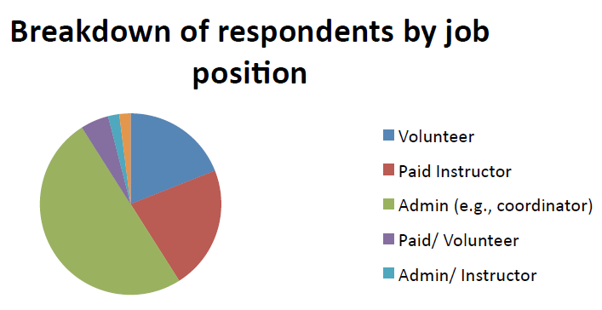
Needs Assessment
Half of the respondents were administrators.
A large number of respondents were volunteers.
Notes:
Slide 7- This slide shows a breakdown of the respondents to our online survey by their job position. The respondents, as you can see were working as instructors, other volunteers, administrators, or in a combination of those positions. The majority of respondents to our survey, though, were program administrators.

Slide 8
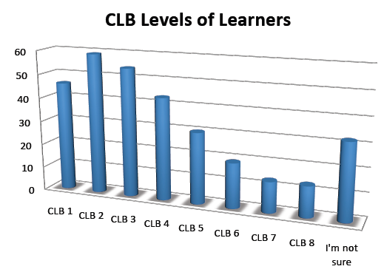
Learners
The most common CLB level was 2.
Several communities reported that 80% percent of their ESL training is for ESL literacy learners.
Notes:
Slide 8- There is no doubt that ESL learners in rural Alberta are found at every CLB level, and from a varying range of educational and cultural backgrounds. However, our research and online survey did reveal some trends. The most common CLB level of students that respondents reported working with were at CLB 1-4. Of these, the most common CLB level was the relatively low CLB 2 with 59 of the respondents indicating that they have learners at that level. Far fewer instructors reported having learners at the higher end of the CLB scale. Only 13 respondents indicated that they had learners at CLB 7 and CLB 8. It should also be noted that 30 respondents indicated that they were unsure of the benchmark levels of their students, which is not surprising given that many of the instructors and volunteers are unlikely to have extensive training in using the Canadian Language benchmarks, or much experience interacting with the CLB assessment system.

Slide 9
Language and literacy levels among rural learners
Trends:
  most common CLB levels of students that respondents reported working with were CLB 1-4
  most common CLB level was CLB 2 with 59% of respondents indicating that they have learners at that level
  CALCs in some communities are dealing with large numbers of learners who have limited literacy in their first language (ESL literacy learners)
Notes:
Slide 9- Our interviews and focus groups also revealed that the CALCs in some communities are dealing with large numbers of learners who have limited literacy in their first language (referred to as ESL literacy learners). In a number of communities, ESL literacy learners make up 80-100% of the learners receiving ESL training. Using technology with ESL literacy learners, especially using computers, can be incredibly challenging and requires a very different approach than using technology with learners who are literate and somewhat tech savvy. It is not surprising then, that 80% of respondents indicated that they would like more information in using technology with literacy learners to deliver ESL.

Slide 10
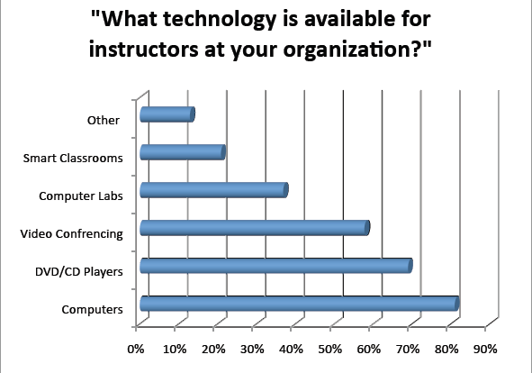
Resources
There was a lot of disparity in the resources available in different communities.
Notes:
It is to be expected that the resources for ESL/e-learning available to the ESL providers in different communities will vary significantly. Many of the people we spoke with in the interviews and focus groups had adequate technological resources for learners and instructors including smart boards and video conferencing equipment. However, this was not universally true and, in one case, the only available resources were two second-hand computers for the instructors and volunteers. This disparity was reflected in the subsequent survey data. Eighty-one% of respondents indicated that the instructors at their organizations had access to computers, 69% had access to DVD/CD players and televisions, and 58% had access to video conferencing. Fewer than half (37%) had access to computer labs, and only 21% had access to smart classrooms.
Another technological issue that arose was the issue of Internet access. Some parts of Alberta are still relying on dial-up Internet services, which make many internet-based activities much more difficult. In fact, when we asked survey respondents to tell us the barriers that impeded use of technology in a rural setting, Internet access was the most common response.

Slide 11
“Do you think that there are immigrants in your area who are not currently receiving instruction who may be served by e‐learning?”
Maybe a small %, but most are Low‐ German Mennonites who would not be well served via elearning
Although we aim to fill as many gaps as possible. Many of the new Canadians in our area work shifts and so can not commit to regular classes or tutoring
I know there are immigrants not currently receiving instruction, but do not know whether they would be well served by e‐learning or not. Most who leave my class are working long hours and had difficulty getting homework done or getting to class. E‐learning relies entirely on the students' motivation, so exhausted learners without accountability and personal contact may not achieve much
Notes:
Slide 11- On slide 11 you can see some of the responses to our question about the potential for e-learning in rural communities. This is feedback on the question, “Do you think that there are immigrants in your area who are not currently receiving instruction who may be served by e‐learning?” from some of the participants. Some other responses included.
I believe there are potential students not being served, especially newly-arrived spouses of immigrants who have been here for some time. In addition to the barriers mentioned above, they often have no access to child care or have time (with home and employment duties) to work on their English.
Another comment was:
Students at higher benchmark levels are usually quite comfortable with technology (computers, Skype, etc.) so if self motivated I think they would appreciate the opportunities of e-learning especially since we are not able to provide structured classroom instruction for these higher levels

Slide 12
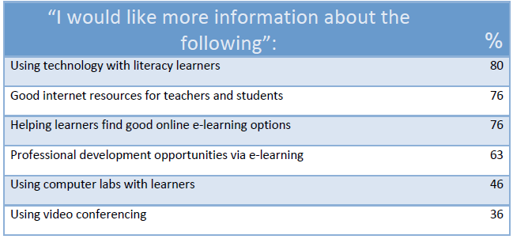
What would be most helpful in a guide for rural Alberta?
Notes:
Slide 12-Clearly, there are very disparate needs among rural ESL providers. This makes the creation of a guide for e-learning and ESL that will be useful for all rural Alberta communities challenging. Fortunately, the information we gathered through our needs assessment gave us some insight into what would be more efficacious for rural providers. The table on slide #12 shows which aspects of ESL/e-learning would be more useful in a guide for rural practitioners. It is apparent that information about how to use e-learning to promote language learning with ESL literacy learners is important. Good online resources for both professional development and for use with learners were also deemed as a priority. Focus group comments and written survey comments also indicated that practitioners would like more information about how to find programs for learners, especially high level learners, who are looking for online training to help them reach their career goals. It is also imperative that the advice contained in the guide, e-learning and ESL in Rural Alberta, be mindful of the fact that all centers may not have all technological resources available and that internet speed can still be a challenging barrier to fully utilizing ESL/e-learning.

Slide 13
Questions & Resources
Pdf versions of the Guide for ESL/e-learning in rural Alberta can be downloaded at no charge from the ATESL Resource Database
Limited hard copies are available from Daylight Consulting.
Requests for information and questions should be emailed to: daylightconsulting@shaw.ca
Notes:
Slide 13- The next webinar in the series is Webinar #2 - An orientation to the Guiding Principles for using e-learning with rural ESL learners. Here you will hear a more detailed description of the Guiding principles of the rural ESL/e-learning Guide, with practical information for program administrators and classroom teachers.
In webinar #3, you will hear about the remaining information included in the Rural Guide, as well as, an introduction to the broader e-learning project, Building skills and expertise for using e-learning with adult ESL learners.
Pdf versions of the Guide for ESL/e-learning in rural Alberta can be downloaded at no charge from the ATESL Resource Database: www.atesl.ca
Limited hard copies may be available from Daylight Consulting.
Requests for manuals, other information and questions should be emailed to: daylightconsulting@shaw.ca
Thanks so much for listening to webinar #1, and for your interest in our project.

