Slide 1
LGBTQ+ in the LINC Classroom
Presented by:
Stacy Norrbom, LINC Instructor
Notes:
Stacy introduce us
Say we will be sharing our presentation on the ATESL website as well as our email addresses if anyone has questions

Slide 2

Overview and objective
Background
Understanding your needs
LGBTQ in LINC themes
Classroom scenarios
How you can be an ally
Questions
To enhance learning by creating a safe and inclusive classroom where all students feel they belong.

Slide 3

Understanding your needs
What is your knowledge
level about LGBTQ
issues?
What is your comfort level with LGBTQ topics?
To what extent have you talked about LGBTQ issues in the classroom? Share some situations.
What information do you need to be more confident including this topic in your curriculum?

Slide 4
LGBTQ+ 101
Lesbian
Gay
Bisexual
Transgender
Queer
+ ally, asexual, intersex, genderqueer, gender non-binary, pansexual, questioning, two-spirited….
Notes:
Transsexual – not widely used, and some consider it offensive

Slide 5
Other terms
Sexual orientation
  A person’s pattern of emotional, romantic, and sexual attraction to another person.
Gender identity
  Each person’s internal experience of gender. Individual sense of being male, female, both, neither, or anywhere along the gender spectrum.
Gender expression
  The way each person publicly presents their gender through such aspect as dress, hair, make-up, body language, and voice.
Sex
  The physical anatomy you were born with.

Slide 6
Brief history – international context
“In all regions, people experience violence and discrimination because of their sexual orientation or gender identity. In many cases, even the perception of homosexuality or transgender identity puts people at risk” (UN report, 2011).

Slide 7
UN High Commission report
III. Violence
  A. Killings, rape and other acts of discriminatory violence
  B. Torture and other forms of cruel, inhuman and degrading treatment
  C. Right of asylum for those persecuted because of sexual orientation or gender identity

Slide 8
UN High Commission report
IV. Discriminatory laws
  A. Laws criminalizing same-sex sexual relations between consenting adults and other laws used to penalize individuals because of sexual orientation or gender identity
  B. Death penalty
  C. Arbitrary arrest and detention

Slide 9
UN High Commission report
V. Discriminatory Practices
  A. Discrimination in employment
  B. Discrimination in health care
  C. Discrimination in education
  D. Restrictions on freedom of expression, association, and assembly
  E. Discriminatory practices in the family and community
  F. Denial of recognition of relationships and related access to State and other benefits
  G. Gender recognition and related issues

Slide 10
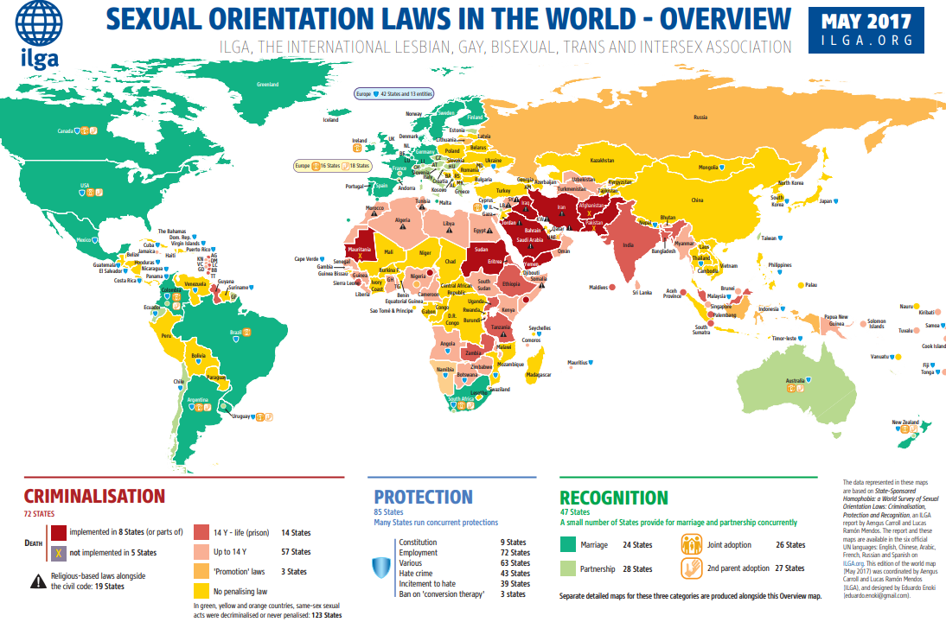
International Laws 2017
Notes:
Death penalty implemented in 8 countries
Imprisonment 74 countries
Some protections – 85 countries
Recognition of marriage 24 states
Recognition of partnership 4 additional states

Slide 11
Brief history – Canadian context
1952 – Gays and lesbians were banned from entering Canada, even as visitors
1969 – Decriminalization of same-sex relationships
1973 – Homosexuality removed from the Diagnostic and Statistical Manual of Disorders
1977 – Ban on gays visiting Canada was lifted

Slide 12
Brief History (cont.)
1995 – Sexual orientation read into the Charter of Rights and Freedoms prohibiting discrimination in renting property, obtaining a job, etc.
1996 – Sexual orientation protected in Canada Human Rights Act
1998 – Sexual Minorities protection read into the Multicultural act as a protected grounds of discrimination

Slide 13
Brief History (cont.)
2002 – Gays and lesbians can sponsor same-sex partners
2005 – Same-sex marriage legalized federally
2009 – Jason Kenney blocked all LGBTQ references in Newcomers Guide to Canada
2011 – Reference made to sexual diversity in 2011 version of Discover Canada
June 19, 2017 – Bill C-16 receives royal assent and gender identity and gender expression become protected grounds in Canada Human Rights Act

Slide 14
What does this mean for our classrooms and our students?

Slide 15


Curriculum as mirror and window (Emily Style)
Curriculum serves as a mirror when it reflects individuals and their experiences back to themselves
and at the same time
Curriculum serves as a window when it introduces and provides the opportunity to understand the experiences and perspectives of those who possess different identities
Notes:
Students need to see themselves reflected in the curriculum, and although some days our classes may seem homogenous, it’s critical to remember that each person comes with vast experience, family and social connections, and diverse personal characteristics. We need to provide opportunity for them to see the various dimensions of their identity (perhaps as a single person, a partner, a student, a spouse, a Canadian, a Somali woman, a Syrian man, a gay woman, a questioning man, or a non-gender conforming individual. Being gay is something we cannot see, so we must always assume that there are students who are gay, have gay relatives, or, at the very least, will meet someone in Canada who is gay.
In my experience, students want the opportunity to learn, not just about language, but about other ways of thinking, other cultures, and most importantly, about their new culture and home.

Slide 16
Benefits of curriculum inclusion - window
For all students
  inclusive and accurate accounts of history
  better understanding of LGBTQ people and their stories, their historic contributions, and their current realities
  promotes acceptance
Notes:
I believe that students WANT to know and accept people who are different from themselves, in all walks of life.
Personal story – I always tell my class a bit about my life, that I am married to a woman and that we adopted children together. Two of the most amusing quotes for me came from Somali women in my class last term:
“This isn’t my first time knowing about this. I saw two women holding hands one day and I thought – Good for you!”
“I think this is great and now you will have a lot of women following you!”

Slide 17
Benefits of curriculum inclusion - mirror
For LGBTQ students
  validates their existence and experiences
  reinforces their value and self-worth
  provides space for their voices
  offers a mirror to reflect this identity

Slide 18
LINC Themes:
Education
Finances
Health
History
Family
Employment
Geography
Housing
Living in Canada
Community
Government and Law
Being a Consumer
How can we include LGBTQ content in these themes?

Slide 19
Themes
Brainstorming
Activity
Notes:
Divide themes among participants
Ask them to answer 3 questions
What are some activities or information you could include about LGBTQ issues for this topic?
Is there anything in this theme that could make LGBTQ students uncomfortable sharing? If so, how can I offer an alternative to that activity?
What additional information do I need to ensure that this activity is successful?

Slide 20
For discussion:
What are some activities or information I could include about LGBTQ issues for this topic?
Is there anything in this theme that could make LGBTQ students uncomfortable sharing? If so, how can I offer an alternative to that activity?
What additional information do I need to ensure that this activity is successful?

Slide 21
General course content
Orientation
  bathrooms at NorQuest are labelled men, women, and all gender/gender inclusive
  diversity and inclusion statement
  rules for respectful communication
News stories/Current events
  gay olympians coming out and serving as role models for younger generations (Gus Kenworthy, freestyle skiier)
  Prime minister Trudeau’s visit to EMCN to discuss LGBTQ asylum seekers
  EMCN has new LGBTQ settlement worker
Grammar
  include two female names or two male names when making examples
  pronouns - he/she/they/zim/zir

Slide 22
LINC themes
Education
  GSAs
  transgender bathrooms debate
  separate school board health curriculum
Finances
  Family budgeting (include LGBTQ/”non-traditional” families in your examples)

Slide 23
LINC themes
Health
  Human rights laws to protect workers from discrimination
  benefits for same-sex partners
  LGBTQ colleagues
History
  Immigration history – include LGBTQ information
  Famous LGBTQ Canadians

Slide 24
LINC themes
Family
  include various representations of family, including same-sex parents, single parents, adoption, donor and surrogate options for having children
  Family chores; family issues (Canadian clothing vs. traditional cultural clothing; sexuality; relationships and dating)
Employment
  protected grounds of discrimination in Alberta Human Rights Act
  benefits for same-sex spouses and partners (including common law)
  LGBTQ colleagues

Slide 25
LINC themes
Geography
  General characteristics of small towns vs. big cities
  Big cities, more diversity of cultures, sexuality, lifestyle
Housing
  protected grounds of discrimination in Alberta Human Rights Act
- finding roommates

Slide 26
LINC themes
Living in Canada
  Pop culture (Modern Family, Will and Grace, Ellen Degeneres, Queer Eye)
  LGBTQ neighbors
Community
- services for various groups, including LGBTQ: Pride Centre, LGBTQ+ Newcomers group; counselling services
- festivals - include Pride festival

Slide 27
LINC themes
Government and law
  Charter of Rights and Freedoms
  same-sex marriage and adoption legal (2005)
  common law includes same-sex partners
  the law reflects the values of citizens
Being a consumer
  Representation in advertising
  What images do we see? What family types are acceptable and welcome?

Slide 28

PBLA!
Filling out forms
  include gender choices and explanations
Writing letters
  use of sir/madam (Mr, Ms, Miss)
Sharing opinions (speaking or writing)
  Do you think parents should be told if their child joins a GSA?
Others?

Slide 29
Classroom scenarios
Notes:
Managing the discussion
Scenario 1
You are presenting a lesson on human rights in the workplace, and discussing the grounds of protection, which include sexual orientation. A student in your class says, “It’s disgusting. I would never want to work with a gay person.” What would you do/say?
Scenario 2
You are talking about family types, and how some families are made up of two moms or two dads because same-sex marriage is legal in Canada. One of the students in your class says, “A pregnant woman told me that she is having a baby to give to two gay men. How does this work?” How could you handle this?
Scenario 3
In a module on family communication, you have prepared a lesson on difficult parent-child conversations. Among issues like “my child failed a class, my child is on drugs, my child is being bullied, my child wants to move back to our home country, my child won’t wear a hijab,” you include the topic “my child told me that she’s bisexual.” A student in the class says they would disown their child if they came home and said they were gay or bisexual, and that gays are killed to save family honour in their country of origin. What would you say to this student?
Scenario 4
You are giving a lesson on neighborhoods and community resources. You include information on services for LGBTQ+ individuals. A student comes up to you after class and discloses that they are gay, want to meet a partner, and would like some more information. What could you offer?
Scenario 5
You show a news video about a transgender woman who has been attacked in a local washroom. A female student says “I wouldn’t want a man in my bathroom. I wouldn’t feel safe.” How could you respond?
Scenario 6
You’re teaching a lesson on immigration history, and you include in the lesson that there has been an increase in refugee claimants coming to Canada because they have been attacked and threatened in their countries of origin because they’re gay. A student in your class says “They’re just looking for a way to get in to Canada. They really aren’t gay.” How could you address this?

Slide 30
How to be
an ally
in the classroom

Slide 31

Examine your biases
What were your earliest messages about LGBTQ people and where did they come from?
  Were they positive? Negative? Neutral?
  How does this affect your teaching?

Slide 32
Educate yourself
Learn the vocabulary and be comfortable using it
Review suggested websites
Pay attention to news stories that highlight current issues (e.g. GSAs in schools, olympic athletes, etc.)
If you’re uncertain, ASK! ☺

Slide 33

Teach inclusively
Include a variety of gender
representations
Think about topics that may be uncomfortable for LGBTQ students (e.g. family, weekend plans, dating and relationships, self-disclosure)
Group neutrally (by number, by birthday month, etc.)
Evaluate your speech and materials for hetero-normative and gender-normative bias (e.g. husband/wife)
Include positive representations of LGBTQ people in your curriculum

Slide 34
Be visible (and audible)
Consider placing a rainbow sticker in your classroom to show you are supportive
Share stories about yourself, or LGBTQ friends or family members where appropriate
Call out homophobic statements and address microaggressions

Slide 35

Most importantly. . .
Build trust
Build rapport
Listen actively
Notes:
Stacy
Talk about issues when they come up – the safe space of the classroom

Slide 36
For reflection
How inclusive is my curriculum of LGBTQ people, history, and events?
How can I ensure that my lessons provide “mirrors” and “windows” for all my students?
How can I control for bias in my lessons as it relates to LGBTQ issues?
What do I need to do to make my lessons more LGBTQ inclusive?

Slide 37

Helpful Resources
ILGA Website (International Lesbian and Gay Association) on Worldwide LGBTQ Laws
http://ilga.org/what-we-do/maps-sexual-orientation-laws/
EGALE Canada (Canada’s LGBTQ Human Rights Organization)
https://egale.ca/
GLSEN: Gay, Lesbian and Straight Education Network (US)
https://www.glsen.org/educate/resources/lesson-plans
The Welcome Friend Association
www.welcomefriend.ca
Heineken Beer Commercial
https://www.youtube.com/watch?v=8wYXw4K0A3g

Slide 38
nohomophobes.com
This website is designed as a social mirror to show the prevalence of casual homophobia in our society. Words and phrases like “faggot,” “dyke,” “no homo,” and “so gay” are used casually in everyday language, despite promoting the continued alienation, isolation and — in some tragic cases — suicide of sexual and gender minority (LGBTQ) youth.
February 20, 2018 StatsebruaryFebruary 20th, 2018
1,720
No Homo tweets
1,901
Dyke tweets
2,078
Faggot tweets
1,298
So Gay tweets

Slide 39
Image Sources
All images are CC0 Creative Commons from Open Clip Art or Pixabay
The original COEXIST image was designed by Piotr Młodożeniec in 2000.

Slide 40

If we lose the right to be different, we lose the privilege to be free.
-Nelson Mandela
Thank-you!
Stacy.Norrbom@norquest.ca
Notes:
Stacy

